Slide 1
House Bill 3320 Implementation Webinar for the Hospital Association of Oregon
Steven Ranzoni, Hospital Policy Advisor
Sarah Grabe, Community Benefit Program Coordinator
June 4, 2024

Slide 2
OHA Staff
Steven Ranzoni, MPH
Hospital Policy Advisor and Hospital Reporting Program Manager
Over 10 years working with the state
Led previous implementation of HB 3076 (2019), which introduced the community benefit minimum spending floor
Sarah Grabe, MPH
Hospital Community Benefit Program Coordinator
2.5 years working with the state, 6 years in community benefit
Joined OHA during HB 3076 implementation

Slide 3
HB 3320 rules in a nutshell
Hospitals must:
Screen a patient for presumptive eligibility of financial assistance (prescreening)
Provide a process for a patient to appeal a denial of financial assistance, in whole or in part
Report new data on financial assistance applications, approvals, denials and collection activities

Slide 4
HB 3320 implementation timeline
2023 Legislative Session
HB 3320 passed
Fall/Winter 2023
OHA drafted rules
February 2024
OHA drafted revised rules
April 2024
DOJ approved finals rules
July 2024
Prescreening rules are effective
September 2023
OHA conducted partner engagement
April 2024
Public comment period and rules hearing
January 2024
Rules Advisory Committee meetings held
May 2024
Final rules submitted to Sec. of State
January 2025
Appeals and data reporting rules are effective

Slide 5
Prescreening
Effective July 1, 2024

Slide 6
Prescreening overview
“Using the process prescribed by the Oregon Health Authority under subsection (3) of this section, a hospital licensed under ORS 441.025 shall screen a patient for presumptive eligibility for financial assistance…”
OHA established rules for prescreening in OAR 409-023-0120.
Prescreening is a new and separate process from an application for financial assistance.
Hospitals are free to develop their own process that complies with requirements in rules.
Prescreening is intended to use readily available information or services to provide automatic financial assistance adjustments without the patient taking action.

Slide 7
Prescreening overview
ORS 442.614 requirements for financial assistance policies
The prescreening process and any resulting adjustment to patient costs must meet the same financial assistance standards as ORS 442.614:
Evaluated on household income, and
In alignment with minimum financial assistance tiers.
Any resulting adjustment to patient costs must be applied before a patient receives a bill.
Prescreening cannot require a patient to provide documentation or verification and cannot negatively impact the patient’s credit.

Slide 8
Before any prescreening actions, the hospital must determine if the patient has existing financial assistance eligibility
ORS 447.615(7) If a patient applies for financial assistance and the hospital determines that the patient is eligible for financial assistance based on documentation provided by the patient, the patient’s eligibility for financial assistance continues for nine months following the hospital’s determination, and the patient may not be required to reapply for financial assistance for services provided during that nine-month period.
Prescreening Process
Determine if patient qualifies for prescreening
Determine if patient is presumptively eligible
Adjust patient costs as necessary prior to sending bill
Notify patient of results

Slide 9
Who to prescreen
Uninsured
Any patient without public or private health insurance coverage
Enrolled in a state medical assistance program
Any type of OHP including CCO or open card or any other state-provided coverage such as CHIP, Healthier Oregon, or Bridge program (basic health plan)
Will owe the hospital $500 or more
Any time the patient’s responsibility amount will be $500 or greater on a single statement
Any other qualifying conditions at the hospital’s discretion
Notes:
If the patient meets any of these conditions, they get prescreened

Slide 10
Hospitals can use information they have available to conduct the prescreening
A hospital may use any of the following means to establish presumptive eligibility:
Existing patient records,
Information routinely collected during registration or admission,
Information voluntarily supplied by the patient,
Hospitals may ask but cannot compel or require information
Previous financial assistance adjustments, or
Existing eligibility for assistance programs like OHP, SNAP, TANF, WIC, free food programs, low-income energy assistance programs, other means tested programs, and
Third party tools, software, or services.

Slide 11
“409-023-0120(11)(b) Evaluations must be based on eligibility criteria established in the hospital’s written financial assistance policy. Evaluations by non-profit hospitals must be based on household income only, and cannot consider household assets or any assessment, evaluation or score that predicts the patient’s propensity or ability to pay;”
When used by a non-profit, any third-party software tools or services must use household income, and cannot use an ability to pay score
Evaluations cannot use asset information for Oregon patients.
Evaluations cannot result in a negative credit impact for the patient.

Slide 12
Hospitals must make good faith efforts to determine presumptive eligibility and make use of information available to the hospital
If any chosen method fails to return usable information on the patient, the hospital must attempt to use other available information prior to declaring that the patient’s presumptive eligibility cannot be determined.
A hospital may use a single source of information if it provides affirmative information on the patient’s income status.
Hospitals must document the methods they use.

Slide 13
“409-023-0120(13) A hospital must notify the patient in writing of the results of the prescreening process, regardless of the outcome. The notification must meet the following standards:”
Hospitals may notify patients by:
Letter;
Email, if the patient has agreed to receive communications this way;
Message on an online patient portal that the patient is a registered user of;
Notice prominently displayed on the billing statement;
An insert accompanying the billing statement; or
In-person acknowledgement signed by the patient.
Notifications must be in plain language and the preferred language of patients and in alignment with translation standards in ORS 442.614.

Slide 14
Notices need to be clear, plain language, and provide specific and actionable information
OHA will release sub-regulatory guidance with suggested language for prescreening notifications.
The notification must clearly state the outcome of the prescreening in plain language for one of the following outcomes:
Presumptively eligible for full financial assistance;
Presumptively eligible for partial financial assistance;
Not presumptively eligible for financial assistance; or
Unable to determine presumptive eligibility status.

Slide 15
Any notice for presumptive eligibility for less than full reduction of patient costs must include information on how to apply for additional financial assistance
That the patient may apply for further financial assistance
How a patient may request and receive a financial assistance application and assistance in completing it
That the patient is eligible to apply for financial assistance for at least 240 days following the first billing statement or 12 months after the patient pays for services, or any additional time period beyond these minimums that the hospital financial assistance policies specify.
Provide specific, direct phone numbers, email addresses, and web links whenever possible. Avoid general numbers, inboxes and websites.

Slide 16
Appeals Process
Effective January 1, 2025

Slide 17
Appeals process overview
“(8)(a) A hospital must have a written process that is in plain English, and in other languages
as required by law, for a patient to appeal a hospital’s denial of financial assistance,
in whole or in part…”
OHA established rules for appeals in OAR 409-023-0125.
Hospitals must have a process to allow patients to correct deficiencies in an application and to appeal a denial for financial assistance.
The appeals process does not apply to prescreening determinations. A patient denied presumptive eligibility may apply for financial assistance and is still entitled to appeal any denials of that application.

Slide 18
Is application complete?
Evaluate application
Is patient cost adjustment 100%
Provide appropriate cost adjustment
Yes
Yes
No
No
Hospital reviews appeal
Send notice
Send notice
Patient corrects application
Patient appeals
Yes
Yes
No
No
Proceed with original decision

Slide 19
A hospital must notify a patient if their application is denied in whole or in part or if the application requires corrections
A hospital must send notice within 10 business days of review that:
Meets plain language standards of ORS 442.614,
May be delivered by mail, email, in person, or through an online patient portal, if the patient is a registered user of the portal,
Must clearly describe if the patient must take corrective action, or if the application has been denied in whole or in part, and
States that the patient may appeal the decision and provide information on how to appeal.
Any financial assistance adjustment for less than 100% reduction of patient costs is a denial in part

Slide 20
A hospital must allow a patient, or an individual working on behalf of the patient, to correct deficiencies in the application
If an application is incomplete or missing information, the hospital must send notice that meets general standards and clearly indicates that the application is incomplete and requires action:
State the necessary corrective actions,
Provide contact information for how the corrections may be submitted, and
Provide contact information for a hospital representative who can answer questions.
Hospitals must allow patients the remainder of the 240-day application window or 45 days from notification, whichever is greater, to correct their application

Slide 21
If a hospital has denied financial assistance, in whole or in part, the hospital must inform the patient that they can appeal the decision
If a hospital has determined that the patient’s eligibility is less than 100% financial assistance, the hospital must send notice meeting general standards that clearly states the outcome of the application review:
State the specific eligibility criteria and how a patient may receive their specific information,
State that the patient may appeal this decision and provide information on how to appeal, and
Provide contact information for a hospital representative who can answer questions.
Hospital must allow the patient the remainder of the 240-day application window or 45 days from notification, whichever is greater, to request an appeal

Slide 22
Appeals notifications must describe how a patient may appeal a financial assistance determination
A hospital must provide at least two options to appeal, at minimum:
The ability to submit a written appeal to the hospital, and
The ability to request that the hospital CFO or designee review the denial.
Notices should provide clear information on how a patient may request an appeal.

Slide 23
If a patient requests an appeal, the hospital must send an acknowledgement and suspend all collection actions
During the pendency of an appeal, a hospital must:
Suspend all collection activities, if initiated,
If the hospital sold the debt under appeal to a collection agency or authorized the agency to collect debts on behalf of the hospital, the hospital must notify the collection agency to suspend collection activities, and
Provide the patient with a written statement in one of the methods mentioned above that:
Confirms receipt of the appeal request,
Confirms suspension of all collection activities, or
Confirms that collection agencies have been notified to suspend collection activities, and
Provides information on any actions the patient may take if they requested a review by the CFO or designee.

Slide 24
A hospital must issue a written determination on the appeal within 30 days of receipt of requested data or final meeting
If final determination is a denial of financial assistance, a hospital may not resume collection activities until patient receives the final notification.
Final notification must include the date in which collection activities will resume.
Final notification must meet plain language and preferred language requirements.

Slide 25
Data Reporting
Effective January 1, 2025

Slide 26
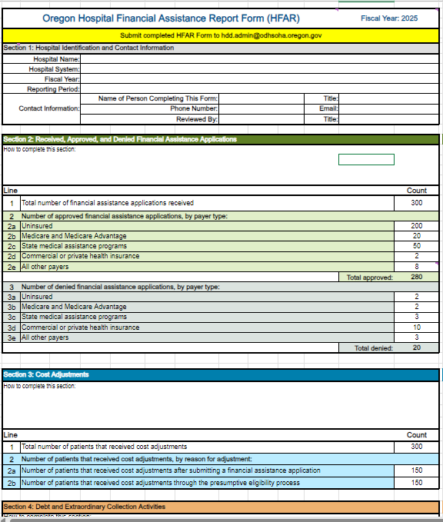
Data reporting form
OHA has drafted the new form Hospital Financial Assistance Report (HFAR) and will solicit feedback to publish the HFAR by September 30, 2024.
Hospitals will begin reporting for fiscal years starting on or after January 1, 2025. HFAR is due no later than 150 days after the close of the fiscal year.

Slide 27
Data reporting elements
Hospitals will publicly report on:
Total # of financial assistance applications received, approved and denied by payer type.
Total # of patients who received cost adjustments with and without completing a financial assistance application.
Total # of patient accounts referred to a debt collector or collection agency.
Total # of patient accounts in which extraordinary collection activities occurred, listed by 26 C.F.R. 1.501(r)-6(b) category.
Average and median per-person debt, and total amount of debt owed by patients whose accounts were in collections or referred to a collection agency.

Slide 28
Resources

Slide 29
Resources
Oregon Health Authority Hospital Reporting Program website, under Hospital Financial Assistance
Steven Ranzoni Steven.Ranzoni@OHA.Oregon.Gov
Sarah Grabe Sarah.Grabe@OHA.Oregon.Gov
General Program Inbox HDDAdmin@DHSOHA.Oregon.Gov
Oregon Administrative Rules 409-023-0100 to 0125

Slide 30
What questions do you have?

